Slide 1
Speech-to-Text and Speech-to-Speech for People Affected by Scanning Speech
Gracie Richards, Gabriel Rodriguez, Pratiksha Pradhan

Slide 2
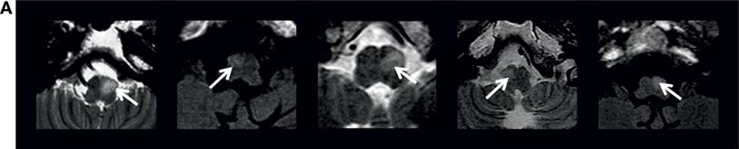
Hypertrophic Olivary Degeneration
A disease that has a rare chance of occurring after a brain hemorrhage, tumor, injury, stroke, cavernous malformation, or brain surgery
Can also be idiopathic, with no known cause
Characterized by degeneration of the olives in the brain
The olives are essential for the cerebellum, the part of the brain responsible for motor control, to function
As a result, HOD affects nearly all aspects of motor function, or movement and coordination
White arrows indicate abnormal inferior olives.
Tilikete C, Desestret V. Hypertrophic Olivary Degeneration and Palatal or Oculopalatal Tremor. Front Neurol. 2017 Jun 29;8:302. doi: 10.3389/fneur.2017.00302. PMID: 28706504; PMCID: PMC5490180.

Slide 3
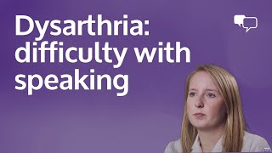
Scanning speech and its challenges
Stroke survivor speaks about difficulties with his speech:
HOD can result in scanning speech, “a type of ataxic dysarthria in which spoken words are broken up into separate syllables, often separated by a noticeable pause, and spoken with varying force”¹
Scanning speech can be found in many conditions, including:
Multiple sclerosis
Stroke
Brain tumors
Brain injury
Parkinson’s disease
ALS
Huntington’s disease
Cerebral palsy
Muscular dystrophy
HOD
¹Scanning speech [Internet]. Wikimedia Foundation; 2024 [cited 2024 Mar 3]. Available from: https://en.wikipedia.org/wiki/Scanning_speech

Slide 4
App functionality
Speech-to-text - for in-person interactions
The phone is shown to the person the user is talking to
Captions in real-time what the user is saying
Speech-to-speech - for messaging
The user creates audio recordings of their voice and the app enhances it
Removes extraneous pauses and speeds up the speech
Can then save or send the audio recording
There is the option to have the recording come with a text transcription
Has the advantage over texting in that it allows them to communicate with their own voice
Preset messages
Can save messages for frequent use
E.g. “Hi my name is ___, I have a disorder called HOD which affects my movements and coordination.”, or their address or phone number.

Slide 5
Discussion
The motor difficulties caused by HOD make speaking a challenge, and it becomes harder for others to understand HOD patients
Although HOD seems to disrupt functionality in all parts of the body, cognition is unaffected
They can think perfectly well, communicating their thoughts is the problem
Our app aims to help people with HOD and other conditions who have scanning speech communicate more easily
The design is speech-to-text and speech-to-speech components trained to recognize scanning speech
Can be used for in-person and virtual interactions
Preset messages allow the user to communicate their most commonly needed phrases with little effort
Notes:
2.5: The act of speaking becomes a frustrating obstacle for them to be understood.
6: And the app is designed to make it even easier for patients:

Slide 6
Challenges
Finding a solution that will help people with HOD
Most aspects of HOD are a mystery – cause is unknown, no treatments
No known genetic cause, and not enough data available
Limited data on HOD available online
Partly because it’s such a rare disease
Few videos of HOD speech available
Only individual case studies are available, no such centralized database
Cannot answer any biological questions in this hackathon (e.g. what cell types are involved in causing the disease, what genes increase risk), so we decided to focus on something that affects patients’ daily life
Implementation
Lack of openly available data out there on scanned speech- cannot use data samples to implement our methodology and create a model based on it
Notes:
We don’t know the cause, there are no treatments or cure, we don’t even know if it is a genetic illness or not.
The data on HOD is mostly in individual case reports, which describe the course of the disease development in each patient, but you have to hunt through the text to find symptoms for example, there might not be a table with the data you are looking for, and there definitely isn’t a central database on all HOD patients
Few videos of HOD speech available, so unless data collection is done with HOD patients, we cannot train our ML algorithm on HOD speech.
(e.g. what cell types are involved in causing the disease), we don’t have a gene or protein we can study

Slide 7
Future Directions
Firstly, creating a HOD-specific database that includes patient clinical and imaging symptoms, treatments, past medical history, scanned speech samples, etc. and encouraging information sharing among organizations
Create the algorithm that trains on scanning speech and is able to recognize it
Build the web app, taking steps to make it accessible to people with motor difficulty
Incorporate more advanced speech enhancement beyond removing extraneous pauses and increasing speech speed, using signal processing and/or machine learning
Can implement multimodal speech-to-text recognition, incorporating lip movements, to improve accuracy of scanned speech recognition
Allow real patients to use the app and improve it based on their feedback

